Slide 1

Boston Housing Data Analysis
Exploratory Data Analysis – Boston Housing Dataset
Year: 2026

Slide 2



OUTLINE
Executive Summary
Introduction
Methodology
Results
Visualization – Charts
Dashboard
Discussion
Findings & Implications
Conclusion
Appendix

Slide 3

EXECUTIVE SUMMARY
Boston Housing Dataset: Key Findings
MEDV is right-skewed (median ~$21K) with significant high-value outliers above $40K
Only 7% of properties border the Charles River (CHAS=1)
Newer homes command ~44% higher median values than older homes
Building age is a strong predictor of home value
Industrial areas (INDUS ~18-19) show NOX concentrations up to 0.87
NOX pollution rises sharply with industrial land use proportion
Pupil-teacher ratios cluster heavily at 20-21, with few resource-rich districts
Dataset: 506 Boston suburban tracts, 13 predictors of median home value

Slide 4

INTRODUCTION
Boston Housing Dataset – Context & Purpose
Dataset: 506 census tracts from Boston area (Harrison & Rubinfeld, 1978)
Target: Median home value (MEDV) and its relationship to 13 housing/environmental features
Purpose: Identify key drivers of home values to support urban planning and policy
Audience: Data analysts, urban economists, policymakers
Variables include crime rate, zoning, NOX pollution, rooms, age, accessibility, tax, school quality
Analysis focuses on 5 key visualizations: MEDV distribution, river proximity, age-value trends, air quality, and school ratios

Slide 5

METHODOLOGY
Data Source & Analytical Approach
Source: Boston Housing dataset (UCI ML Repository / sklearn.datasets)
506 observations, 13 numeric features + 1 binary (CHAS)
Tools: Python (pandas, matplotlib, seaborn) for EDA and visualization
Steps: Load → inspect missing values → descriptive statistics → visualize distributions & relationships
AGE_GROUP variable engineered: Young (<35%), Middle (35-70%), Old (>70% pre-1940 units)
Outlier analysis via boxplot; correlation explored via scatter plots

Slide 6
Results
Five exploratory visualizations reveal patterns in housing values, environmental quality, and school resources across Boston’s 506 census tracts.

Slide 7
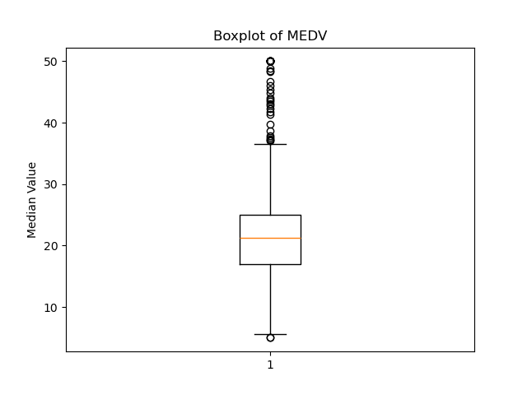
MEDV DISTRIBUTION (BOXPLOT)
Key Insight
Median home values center around $21,000. The distribution is right-skewed with notable outliers above $40,000. The IQR spans

Slide 8
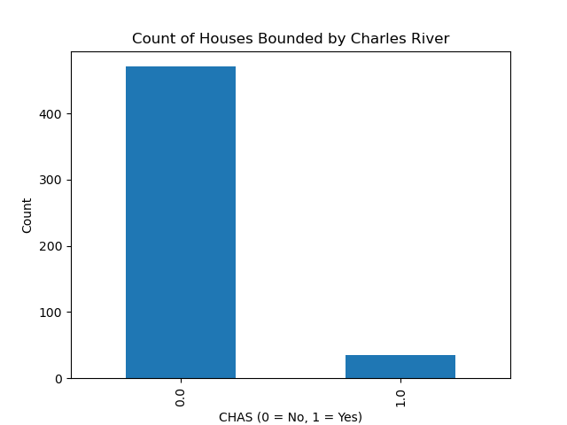
CHARLES RIVER PROXIMITY (CHAS)
Key Insight
Only ~7% of homes (~35) are bounded by the Charles River (CHAS=1). The vast majority (~471) are not river-adjacent, making river proximity a rare attribute in this dataset.

Slide 9
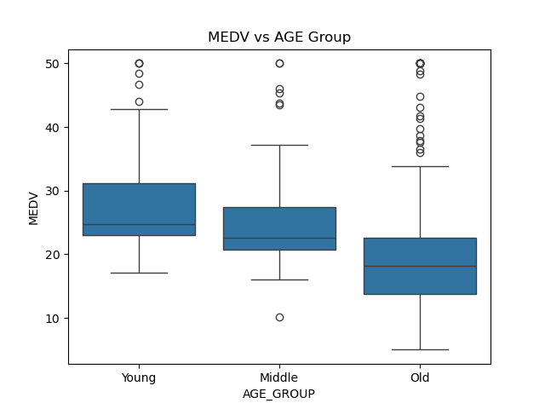
HOME VALUES BY BUILDING AGE GROUP
Key Insight
Newer homes (Young) command higher median values (~$26K) vs. older homes (Old, ~$18K). Older neighborhoods show more value compression, suggesting age is a meaningful predictor of MEDV.

Slide 10
HOME VALUE & RIVER PROXIMITY – FINDINGS
Findings
MEDV median is $21K with IQR of $8K, indicating moderate spread
Outliers above $40K (capped at $50K) suggest data censoring or luxury pockets
Only 35 tracts (~7%) border the Charles River
Implications
River-adjacent land may command premium pricing worth investigating
Outlier tracts may need separate modeling treatment
Class imbalance in CHAS limits its predictive power without weighting

Slide 11
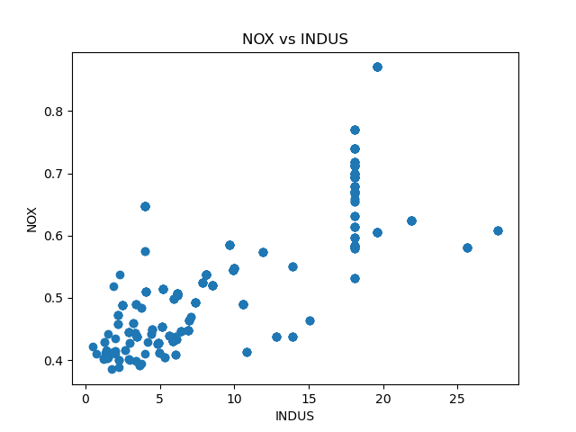
NOX POLLUTION VS. INDUSTRIAL LAND (INDUS)
Key Insight
NOX emissions increase with industrial land share. A cluster near INDUS=18-19 shows elevated NOX (~0.65-0.87). Low-industrial areas maintain NOX below 0.55.

Slide 12
AGE & POLLUTION – FINDINGS & IMPLICATIONS
Findings
Young homes have median MEDV ~$26K vs ~$18K for Old homes
Industrial zones (INDUS ~18-19) form a pollution cluster with NOX up to 0.87
Low-industry areas (<5%) consistently maintain NOX below 0.55
Implications
Age and NOX are strong candidates for inclusion in predictive models
Targeting industrial zones for remediation could raise neighborhood values
NOX-INDUS relationship supports zoning policy recommendations

Slide 13

ADDITIONAL ANALYSIS
Extended findings on school resources, demographic patterns, and cross-variable relationships.

Slide 14
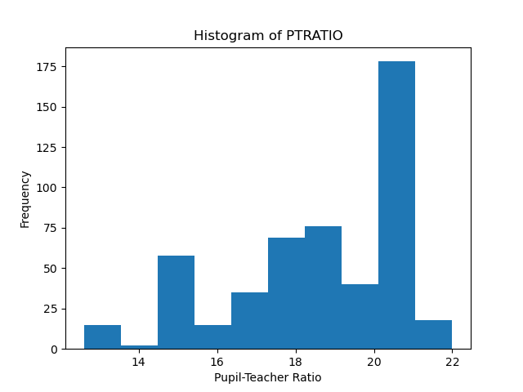
PUPIL-TEACHER RATIO DISTRIBUTION
Key Insight
PTRATIO is heavily concentrated at 20-21, suggesting many districts share a common staffing standard. Ratios below 14 are rare, indicating a left-sparse distribution with few low-ratio (resource-rich) schools.

Slide 15
PTRATIO – FINDINGS & IMPLICATIONS
Key Finding
School Resources
Most districts cluster at PTRATIO 20-21, pointing to standardized class sizes. Only a small minority of tracts fall below 14, suggesting that low ratios (better-resourced schools) are geographically concentrated and potentially linked to higher MEDV.

Slide 16
CROSS-VARIABLE RELATIONSHIPS
Correlation Summary
Variable Interactions
NOX and INDUS are strongly correlated. AGE negatively predicts MEDV. PTRATIO inversely correlates with home values. CHAS shows modest positive association with MEDV. These relationships suggest a combined model using AGE, NOX, and PTRATIO would be highly predictive.

Slide 17
DISCUSSION
This analysis reveals that Boston home values are shaped by a constellation of factors: neighborhood age, industrial proximity (and related air quality), school resources, and geographic features like river adjacency. Older, more industrial tracts with higher pupil-teacher ratios consistently show lower median values. These patterns suggest policy interventions around environmental remediation, school funding equity, and preservation of green corridors could materially lift home values in underperforming tracts.

Slide 18
OVERALL FINDINGS & IMPLICATIONS
Findings
Building age is inversely related to home value across all age groups
Industrial activity and NOX pollution are tightly coupled and concentrated geographically
School resource ratios (PTRATIO) are bimodally distributed, indicating systemic inequality
Implications
Predictive models should include AGE, NOX, PTRATIO as primary features
Policy levers: industrial zoning reform, school investment in high-PTRATIO areas
River proximity (CHAS) is a rare but potentially high-value attribute for further study

Slide 19

CONCLUSION
Boston home values are strongly influenced by neighborhood age, industrial land use, and school quality
Environmental factors (NOX, INDUS) cluster geographically and correlate with lower MEDV
Pupil-teacher ratio distribution reveals resource inequality across districts
EDA confirms multiple actionable predictors for regression modeling and policy planning

Slide 20

APPENDIX
Dataset: Harrison, D. & Rubinfeld, D.L. (1978). Hedonic prices and the demand for clean air. Journal of Environmental Economics and Management. | Variables: CRIM, ZN, INDUS, CHAS, NOX, RM, AGE, DIS, RAD, TAX, PTRATIO, B, LSTAT, MEDV | Source: UCI ML Repository

